Slide 1
The Bible, Christian Anthropology, & Vocation
Catechetical Overview Session 2
“Faith is the assurance of things hoped for, the conviction of things not seen.” —Hebrews 11:1

Slide 2
Game
Do you love your neighbor?

Slide 3
H.A.B.I.T.S.
H – Holy hour: Start with 10 minutes of daily prayer and watch it grow over time to an hour.
A – Accountability: Be transparent with at least one friend who will hold you accountable
to being a disciple.
B – Bible prayer and study: Let God’s Word transform your mind and connect you to Jesus in prayer.
I – Invest in your parish: Tithe and serve in the mission of the parish.
T – Tell: Boldly tell others about your faith and invite them to faith in Jesus.
S – Sacraments: Participate as frequently as you can.

Slide 4
Sacred Scripture: Story of Salvation

Slide 5
Bible
73 books that combine to tell a single story = Christ
Books make the Canon
Orthodox - teaches authentic Church teaching
Universal - read in all churches
Liturgical - read aloud
Apostolic - by apostle or immediate disciples
Gnostic Gospels - written well after the apostles and not part of Canon
As far away from Jesus as us from Abraham Lincoln

Slide 6
Bible
Catholic Canon = Deuterocanonical books
46 Old Testament Books
27 New Testament Books
Written by men inspired by the Holy Spirit
Human and Divine dimensions
Without error - man wrote God’s revelation in own literary style

Slide 16
Christian Anthropology: Made for God

Slide 17
Small Group
How would you respond to the following?
The Bible is not “God’s Word” because it was written by human authors?
The Church added books to the Bible in order to support false teachings like purgatory or praying for the deceased.
Why is it true to say “ignorance of Scripture is ignorance of Christ”?

Slide 18
Small Group
What is the difference between being a someONE and a someTHING?
What is significant about being made in God’s image? In what ways do we share in God’s nature?

Slide 19
Divine Nature
We share in God’s nature inasmuch as we have:
Intellect
Free will
The capacity for love
Are made for communion

Slide 20
Small Group
Q- How can a communion of persons between husband and wife be an analogy for God’s relationship with those who choose Him? In what ways can a husband and wife reveal love for each other like God does for us?
Q- St. Augustine said, “You have made us for yourself, O God, and our hearts are restless until they rest in you.” Have you found this to be true? If so, what are specific times in your life you have experienced the restlessness without God or the joy of being with God?

Slide 21
Questions?
What do you want to know about living as God’s someone, not a something?

Slide 22
Marriage: Trinitarian Image on Earth

Slide 23
Marriage: What does “I love you” mean?

Slide 24
Sacramental Marriage
1601 "The matrimonial covenant, by which a man and a woman establish between themselves a partnership of the whole of life, is by its nature ordered toward the good of the spouses and the procreation and education of offspring; this covenant between baptized persons has been raised by Christ the Lord to the dignity of a sacrament."

Slide 25
Sacramental Marriage
Sacramental = bound together by God (Mt 19:6)
Couple cooperates with God’s action in their life and have Christ living and acting in their relationship
God’s love becomes present in their total union = Grace
Flows through them to their family and community

Slide 26
Sacramental Marriage
Four Qualities:
Free
Total
Faithful
Fruitful

Slide 27
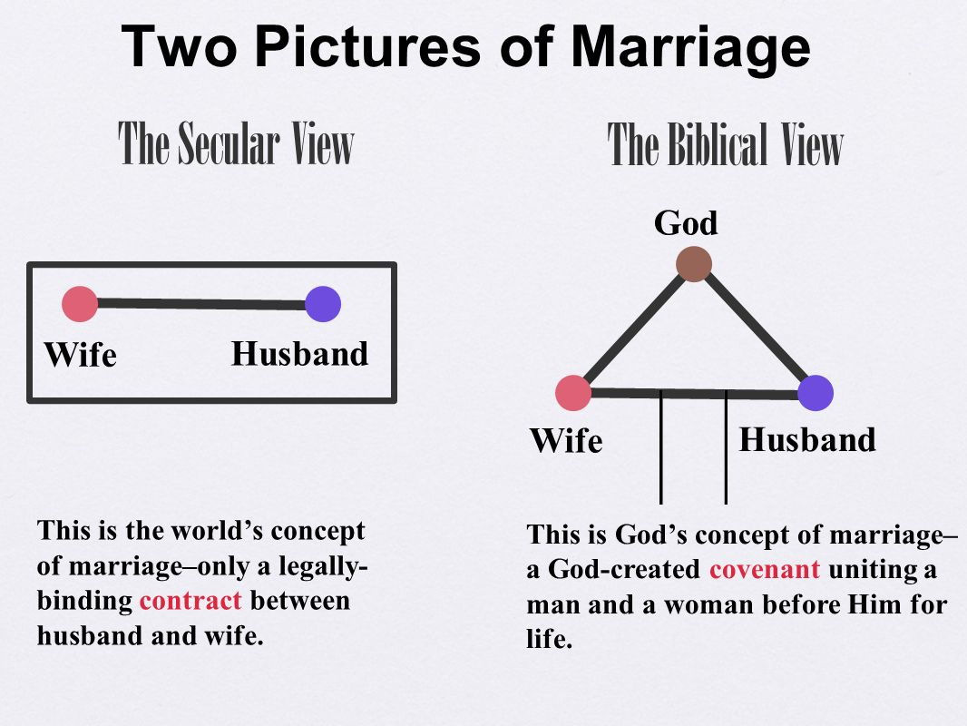

Slide 28
Contract vs. Covenant
Contract: if one party violates the contract then it is considered broken
Covenant: both parties agree to hold up their ends regardless of whether the other party keeps their part of the agreement

Slide 29
Vow
"I, ______, take you, ______, to be my wife/husband. I promise to be true to you in good times and in bad, in sickness and in health. I will love you and honor you all the days of my life."

Slide 30
Ecclesiastes 4:9-12

Slide 31
Questions?
What do you want to know about living as God’s someone, not a something?
What do you want to know about the vocation of marriage?

Slide 32
Vocation and Discernment
Ask, Seek, Knock: Wanderings of a Restless Heart

Slide 33
Vocation
'vocare' latin, to call, to summon
"Love is the fundamental and innate vocation of every human being" CCC 2392
The glory of God is a fully alive human being - St. Irenaeus

Slide 34
Vocation
Takeaways:
1. There is no single perfect vocation other than each individual's vocation lived out to the fullest degree.
2. God uses the ordinary to speak to us. Discernment is intertwined in our daily life.
3. God loves us. Our vocation is His invitation for us to receive that love as abundantly as possible.

Slide 35
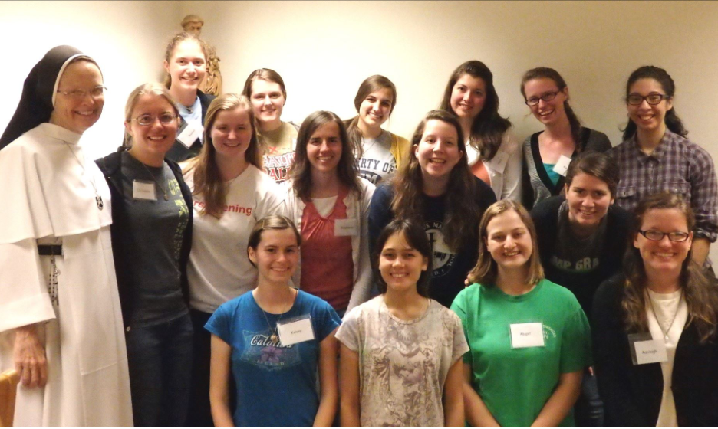
Ask, Seek, Knock: Wanderings of a Restless Heart

Slide 36
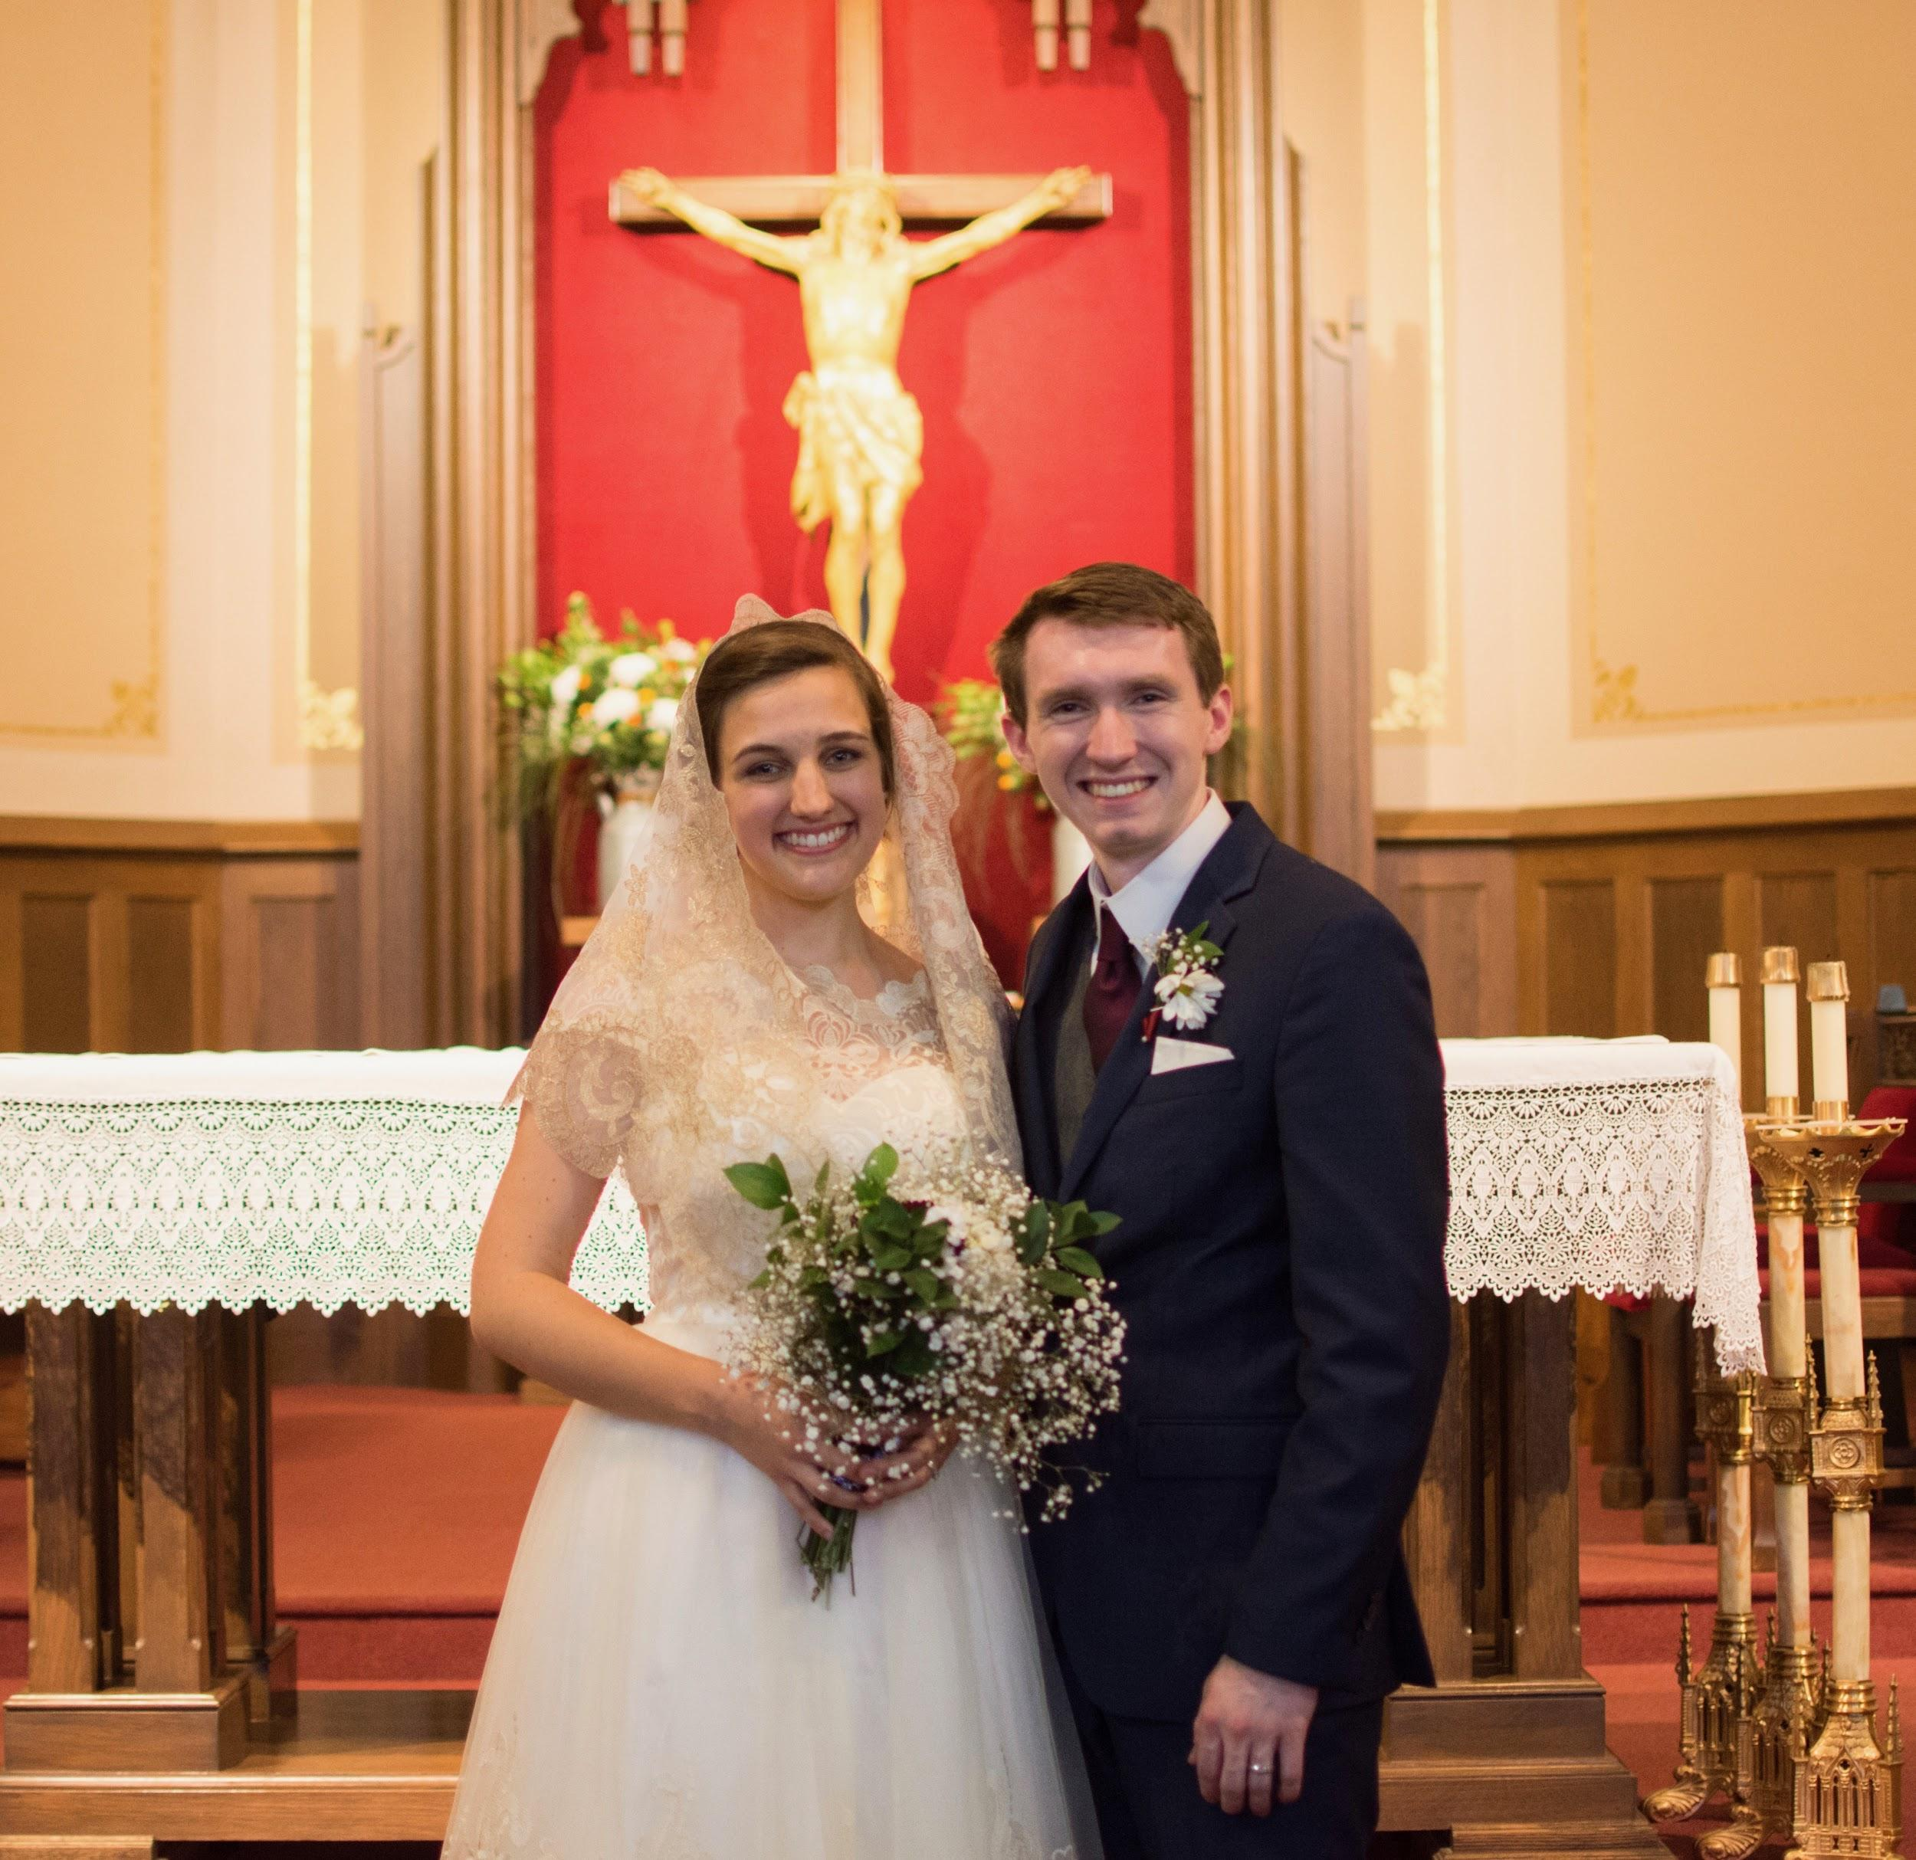
Ask, Seek, Knock: Wanderings of a Restless Heart

Slide 37
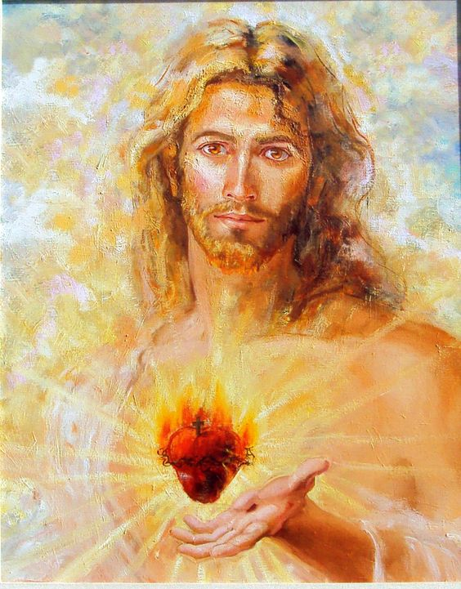
Ask, Seek, Knock: Wanderings of a Restless Heart

Slide 38
Questions?
What do you want to know about living as God’s someone, not a something?
What do you want to know about vocations to religious life or marriage?
What do you want to know about discerning your vocation?

Slide 39
Reflection
How does Jesus show his love for us?
Stations of the Cross
Personal Reflection and Thanksgiving

Slide 40
Holy Orders
What is a priest?2:45
https://ascensionpress.com/study/play/26547/section/418

Slide 41
Finding Your Vocation
How do you hear your call?7:03
https://ascensionpress.com/study/play/26547/section/420

